Slide 1
Title: VisualPhishNet Zero-Day Phishing Website Detection by Visual Similarity
Team:
RAHUL MARRU
KUSHWANTH NEELA
MANIVARDHAN REDDY PINDI

Slide 2
Agenda
Problem Statement
Introduction
Background
key challenge
Architecture
VisualPhishNet – Triple CNN algorithm
Result
Conclusion

Slide 3
Problem Statement
The goal of the project to solve the classification problem of detecting the phishing websites based on their webpage features in the categories of "Legitimate" or "Phishing".
The solution will be a python program based on some deep learning algorithms.

Slide 4

Introduction
Now a days phishing attacks happen to steal the personal privacy data of every user credentials like bank account details.
According to resource [1], United States as $5.8 billion loss per year by various phishing attacks.
[1] https://www.ftc.gov/news-events/news/press-releases/2022/02/new-data-shows-ftc-received- 28-million-fraud-reports-consumers-2021-0
This Photo by Unknown author is licensed under CC BY-SA-NC.

Slide 5
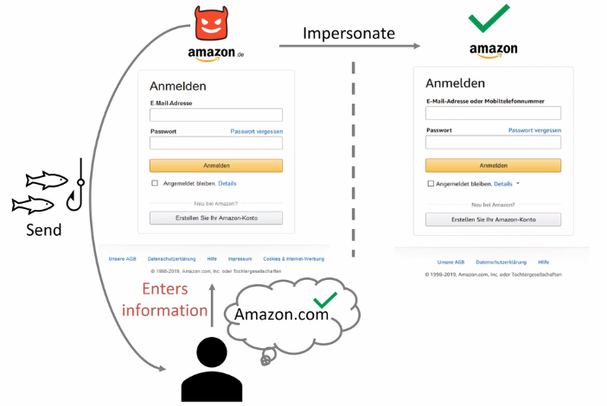
Background
A web page looks similar to the original website, but it steals users' credentials for a user by unnoticed.

Slide 6
Prior Work
Previous the authors done work on this problem into 2 kinds:
- By Page-based similarity approaches.
The similarity between phishing and trusted pages can be inferred by comparing HTML features.
The author Huang[1], in his study extracted features that represent the text content and style (e.g. most frequent words, font name and color, etc.), which they used to compare pages against trusted identities.
On other side, Professor Liu [2] he worked on segmented a webpage to blocks based on HTML visual cues and compared the layout of two pages by matching blocks.
[1] Chun-Ying Huang, Shang-Pin Ma, Wei-Lin Yeh, Chia-Yi Lin, and Chien-Tsung Liu. 2010. Mitigate web phishing using site signatures. In Proceedings of the IEEE Region 10 Conference (TENCON).
[2] Wenyin Liu, Xiaotie Deng, Guanglin Huang, and Anthony Y Fu. 2006. An antiphishing strategy based on visual similarity assessment. IEEE Internet Computing 10, 2 (2006), 58ś65.

Slide 7
- Image-based similarity approaches:
The Authors Chang and Dunlop [3] used logo extraction to determine a website’s identity and then used the Google search engine to find corresponding domains.
Besides other researcher Woodbridge [4] solved problem by CNNs algorithm for detecting visually similar URLs that training on URLs rendered as images.
There are some more work done previously other researchers among them, these major points.
[3] Ee Hung Chang, Kang Leng Chiew, Wei King Tiong, et al. 2013. Phishing detection via identification of website identity. In Proceedings of the IEEE International Conference on IT Convergence and Security (ICITCS.
[4] Jonathan Woodbridge, Hyrum S Anderson, Anjum Ahuja, and Daniel Grant. 2018. Detecting Homoglyph Attacks with a Siamese Neural Network. In Proceedings of the IEEE Security and Privacy Workshops.

Slide 8

key challenge
Similarity-based detection methods do not offer sufficient protection for the trusted websites, in particular against unseen phishing pages.
A new model VisualPhishNet framework based on similarity metrics of websites to detect websites.

Slide 9

Looks similar to the original website but has a new design and color scheme.
The main challenges to this solved by improving the major aspects such as:
1. Dataset for VisualPhish:
- With large database of websites and variability in both training and test images.
2. The approach which is mentioned in before, VisualPhishNet:
- New method in deep learning approach along with images are learned by metric not with image matching. The goal to detect the unseen pages.

Slide 10
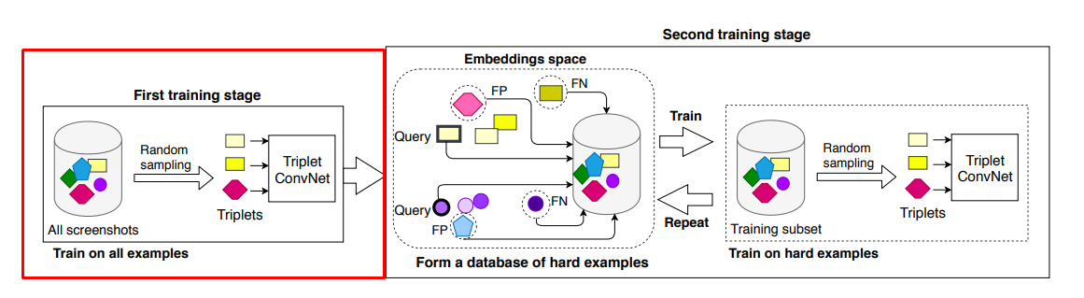
Architecture
The VisualPhishNet framework is combination of three shared Convolutional Neural Networks (CNN) model of triplet network it consists of 3 stages:

Slide 11
Triplet Network
The Siamese networks are two networks the goal of learning a parameter with same shared weights to train. In that sub-networks shares parameters and weights updates modified with mirrored for each of them.
Loss function that minimizes distance for similar objects and maximizing the distance of distance for dissimilar objects.
The triplet network now used in VisualPhishNet extends this approach with CNN algorithm. To denote pixel-wise similarity, we used the distances between the pre-trained VGG16 visual representation instead of naive pixel comparison.
For computed the minimum distances between the phishing pages and the corresponding targeted website. Then compared them to the distances between the legitimate test set (other websites) and the trusted-list. If the phishing pages had similar counterparts in the trusted-list, they would have considerably smaller distances compared to other benign pages.

Slide 12
Reason for using Triplet Network
The main motivation of this model because the problems like face recognition, signature verification and character recognition are successfully solved using deep learning triplet network.
In these applications, first compare the identity of an image with contrast database and then the model checks database whether the identity is matching or not.
These reasons make suitable this model for similarity – phishing detection.

Slide 13
Triplet Sampling
Due to large number of triplet sets are possible. Basically, training is done as sampling or mining of triplets instead of all sets at once.
Therefore, training process has two training stages. In first stage taking the uniform random sampling of triplet to train most sets with CNN algorithm(Pre-train).
Then in second stage the random sampling is trained to fine-tuned the model to find the hard examples to form a new training subset.
In that taking a randomly sample a query set to compare the one screen shot from each website to do latest model to compute the L2 distance between the embedding of the query set with the rest of training screenshots.

Slide 14
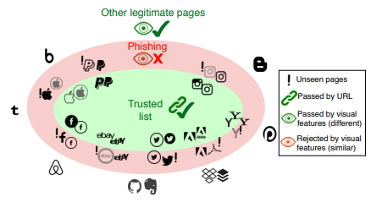
Data used for this problem
Trusted pages are granted based on their URLs. The remaining pages are compared to the trusted pages by a learnt visual similarity metric. Pages that that are too similar are rejected, which even allows detecting phishing pages with new visual appearances.

Slide 15
Dataset
The dataset consists of a collection of legitimate and phishing screenshots taken from 155 websites instances available by open source.
Total number of instances: 9000 training samples.
"visual similarity metric between any two same-website webpages’ screenshots, instead of relying on one-to-one matching, which outperforms prior work by a large margin".
Dataset Source link by author:
https://oc.cs.uni-saarland.de/owncloud/index.php/s/QcBJyLjn9oEiXxB

Slide 16
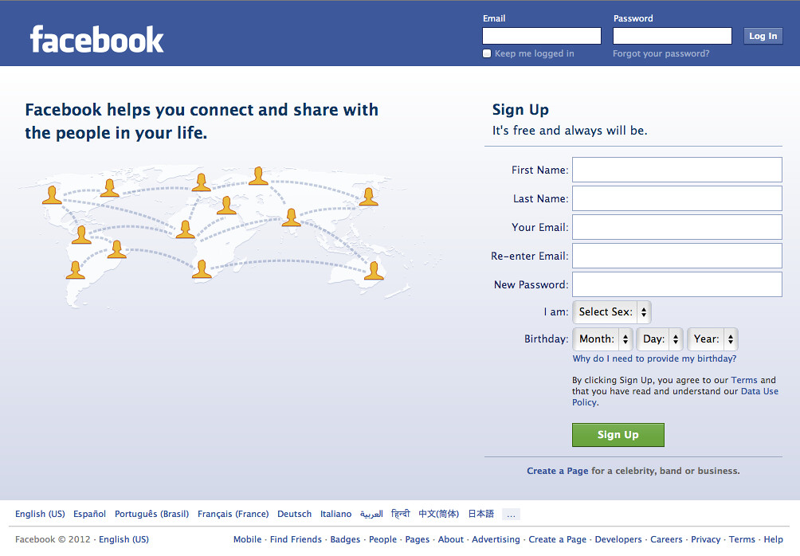
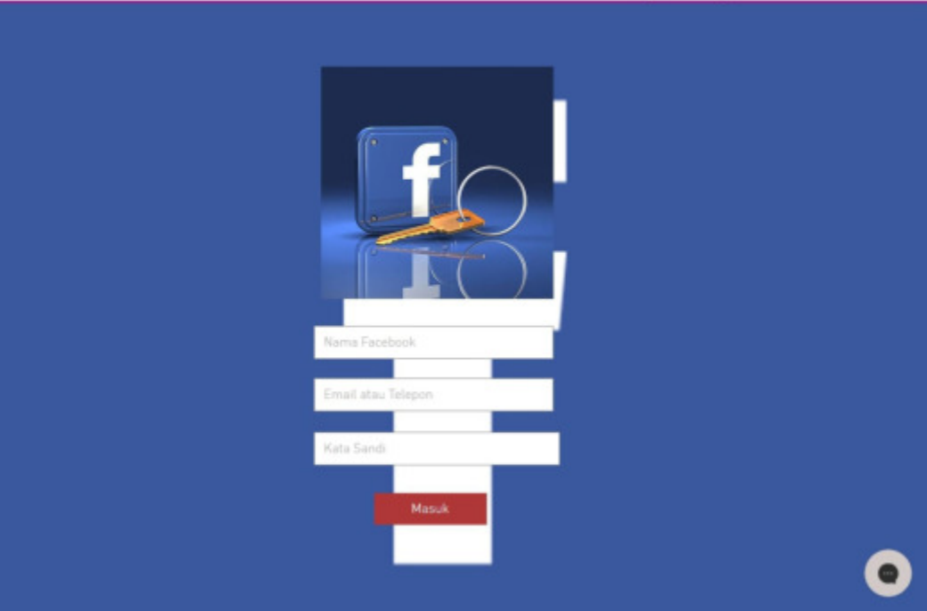
Sample Legitimate Web page and Phishing Web page
Legitimate Facebook Page
Phishing Facebook Page

Slide 17
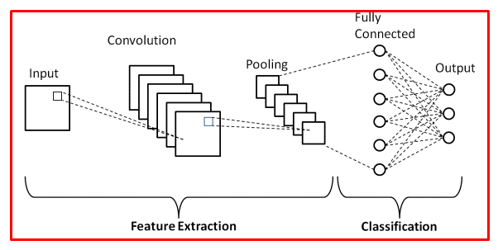
Pre-training the images with CNN Algorithm
A convolution tool that separates and identifies the various features of the image for analysis in a process called as Feature Extraction.
The network of feature extraction consists of many pairs of convolutional or pooling layers.
This CNN model of feature extraction aims to reduce the number of features present in a dataset. It creates new features which summarizes the existing features contained in an original set of features. There are many CNN layers as shown in the CNN architecture diagram.

Slide 18
The proposed CNN architecture is a 1D CNN consisting of two convolutional layers and two max pooling layers. These are followed by a Fully Connected layer of N units, which is in turn connected to a final classification layer containing one neuron with a sigmoid activation function.
The sigmoid activation function is given by:
The convolutional layers utilize the ReLU (Rectified Linear Units) activation function given by: f(x) = max(0,x)
ReLU helps to mitigate vanishing and exploding gradient issues.
It has been found to be more efficient in terms of time and cost for training huge data in comparison to classical non-linear activation functions such as Sigmoid or Tangent functions

Slide 19
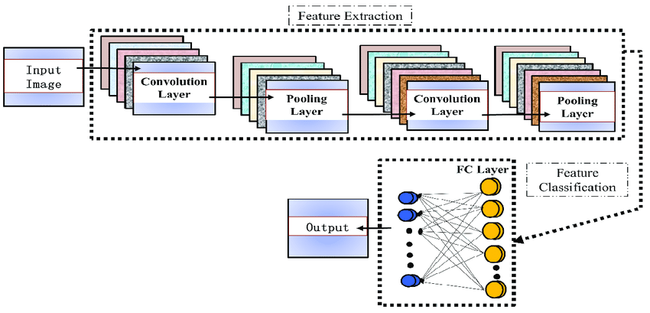
Vector Embedding
Vector Embedding is extracting the features for images before training with CNN algorithms as input.

Slide 20
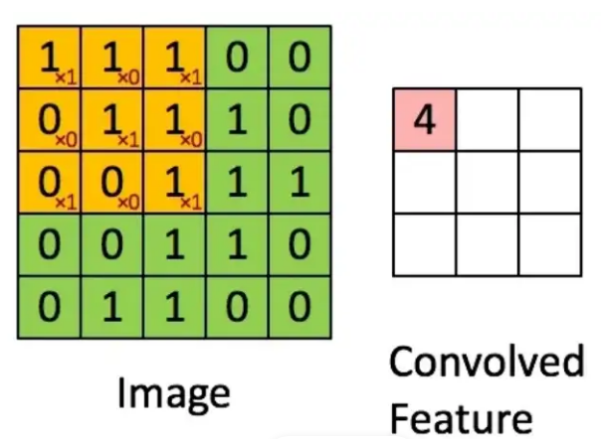
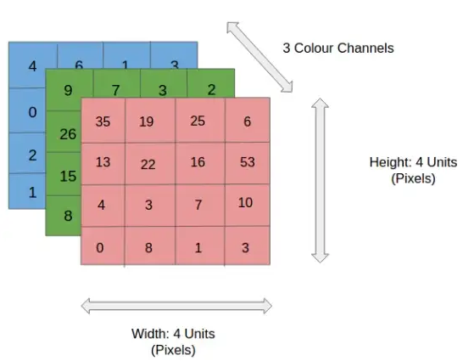
What are convolutions?
The value of the convolved feature when the Kernel is applied to the input image.
The CNN learns the weights of these Kernels on its own. The result of this operation is a feature map that basically detects features from the images rather than looking into every single pixel value.
RGB color channels of an image.

Slide 21
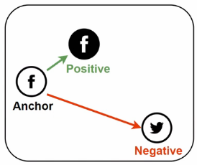
VisualPhishNet
Use triple loss to learn a similarity metric between same-website pages. The method training objective is
Same-website pages -> smaller distances in the embedding space if website is matching with same site.
Different-website pages -> larger distances in the embedding space if the website is not matching with same site(different site).

Slide 22
To achieve minimizing the loss function by:
Where, f(x) = represents the embedding space (produced by a shared network),
(Xª_{i,} X^{p}_{i,} X^{n}_{i} ) is a set of possible triplets (anchor, positive, and negative), and
𝛼 is a margin that is enforced between positive and negative pairs which achieves a relative distance constraint.

Slide 23
Inference
Use the minimum distance of a query image to the training trusted-list to determine:
The phishing or legitimate web pages classification.
At test time, the closest screenshot in distance to a phishing test page targeting a website should ideally be a screenshot of the same website.
Therefore, the decision is not done based on all triplets comparison but it can be done by finding the screenshot with the minimum distance to the query image.
After computing the pairwise distances, the test screenshot is assigned to the website of the screenshot that has the minimum distance. This step could identify the website targeted if the test page is a phishing page.

Slide 24
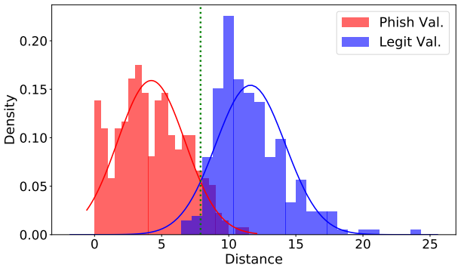
Histogram Graph to closest examples of test images and observed that phishing websites are closest to training trusted-list.

Slide 25
EVALUATION Metrics of VisualPhishNet
Hence, this is binary classification such as output is either legitimate or phishing is evaluated based on the visual similarity of a phishing page to websites in the trusted-list, we computed the percentage of correct matches between a phishing page and its targeted website.
To calculate overall accuracy at different distance thresholds to calculate the Receiver Operating Characteristic (ROC) curve area.
Code Source:
https://github.com/S-Abdelnabi/VisualPhishNet

Slide 26
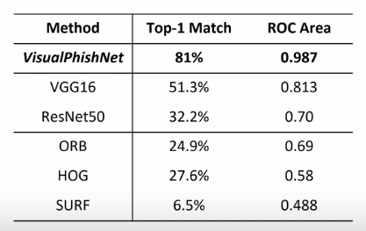
Result
Using VisualPhishNet, 81% of the phishing test pages were matched to their correct website using the top-1 closest screenshot, while the top-5 match is 88.6%.
After computing the correct matches, we computed the false positive and true positive rates at different thresholds (where the positive class is phishing) which yielded a ROC curve area of 0.9879 (at a cut-off of 1% false positives, the partial ROC area is 0.0087) outperforming the examined models and re-implemented visual similarity approaches.
Comparing performance with previous methods.
VisualPhishNet outperforms pretrained ConvNets
and image feature matching to target image along
with ROC curve area.
VisualPhihNet has achieved high accuracy
of Top-1 Match is 81%.

Slide 27
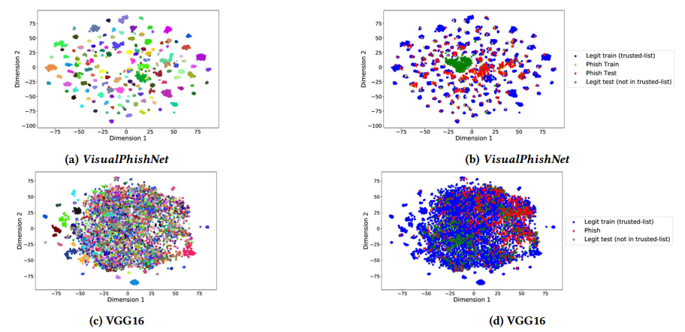
Comparing the models with graphically
With the visualizations of VisualPhishNet’s embeddings compared with the pre-trained VGG16 ones as a baseline. Each color respects a website. When comparing the colors in graph blue, red, green to respect as legitimate , phishing and legitimate test websites.
Considering the output that VGG16 does not perform well, image matching method is not sufficient to find the unseen trusted webpages.

Slide 28
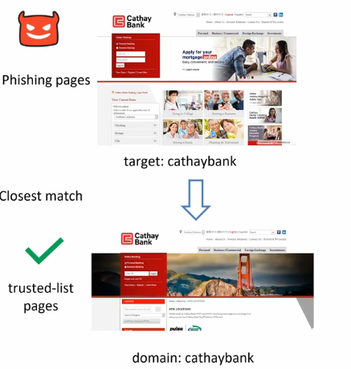
Successful Classification
Phishing pages with similar layout but other content differences (e.g. Colors, background images).

Slide 29
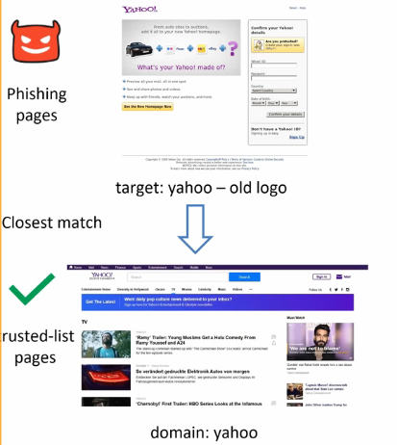
Phishing pages with different logo's designs (older or newer versions than the trusted-list)

Slide 30
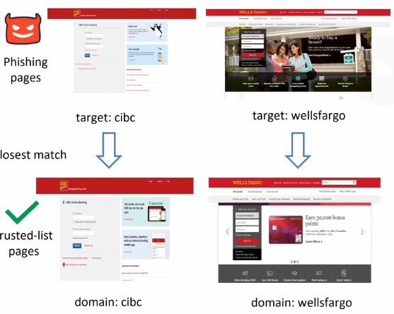
Different websites with similar colors that were distinguished from each other.

Slide 31
Conclusion
In this approach worked with an improved dataset of 155 websites included of biggest trusted-list so far and higher variability in training and test web pages images.
Evaluating the website pages in commonly used image to image matching, now with new approach VisualPhishNet that measure the visual similarity by learning a similarity metric among same webpage screen shots.
Image descriptors matching.
Layout segmentation blocks matching.
L2 distance calculated in between embedding space.

Slide 32
References
Teh-Chung Chen, Scott Dick, and James Miller. 2010. Detecting visually similar web pages: Application to phishing detection. ACM Transactions on Internet Technology (TOIT), Vol. 10, 2 (2010), 5.
Kuan-Ta Chen, Jau-Yuan Chen, Chun-Rong Huang, and Chu-Song Chen. 2009. Fighting phishing with discriminative keypoint features. IEEE Internet Computing, Vol. 13, 3 (2009), 56--63.
Ee Hung Chang, Kang Leng Chiew, Wei King Tiong, et al. 2013. Phishing detection via identification of website identity. In Proceedings of the IEEE International Conference on IT Convergence and Security (ICITCS).

Slide 33

Thank you
https://forms.microsoft.com/r/SVVtM7WjZc

